Slide 1

Predicting Airline Passenger Satisfaction
Airin Konno

Slide 2
Aim
Given survey data from an airline, predict customer satisfaction (satisfied or dissatisfied).
Business Value
Upgrade the airline's services through customer feedback.
Enable the efficient use of people, time, and money to improve the more significant variables.
Boost airlines profitability in the long term (higher satisfaction = higher customer retention).

Slide 3
Data Collection
Dataset from Kaggle.
Already split into train (80% of data) and test (20% of data) files.
Total Dataset: 129,880 records with 25 columns
Train: 103,904 records
Test: 25,976 records
Categorical variables include:
Gender, customer type, type of travel, class
Target variable: Satisfaction

Slide 4
Data Preprocessing
Dropping unnecessary columns.
Checking for null values.
Filling in Arrival Delay in Minutes with the median.
Encoding categorical values into numbers.
Ordinal encoding for ordinal variables:
Customer Type: Disloyal, Loyal
Class: Economy, economy plus, business
Satisfaction: Neutral or dissatisfied, satisfied
One hot encoding for variables with no order:
Gender: Female, male
Type of Travel: Personal travel, business travel
Drop first = True
Feature scaling with Standard Scaler
Unnamed0
id
Checking for data imbalance.
Neutral or dissatisfied: 56.7%
Satisfied: 43.3%

Slide 5
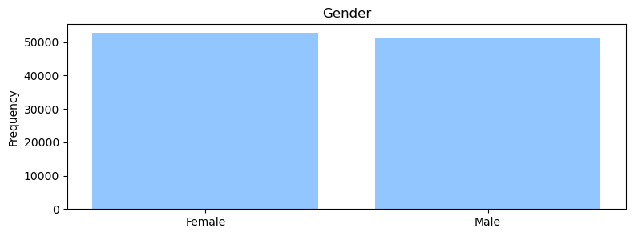
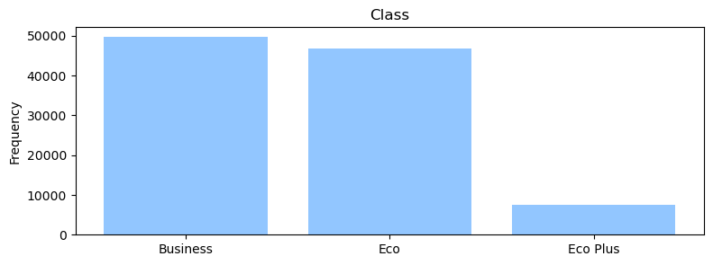
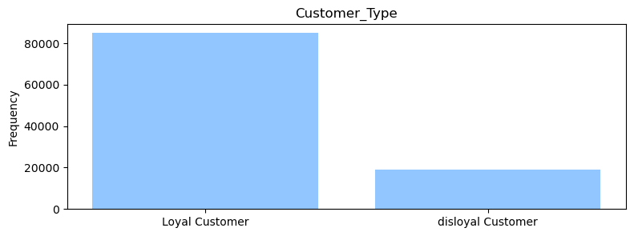
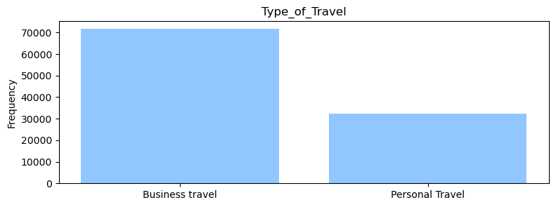
EDA – Categorical Variables Distribution

Slide 6
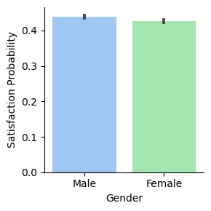
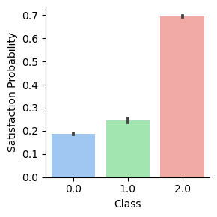
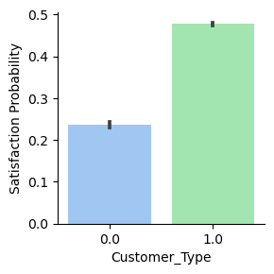
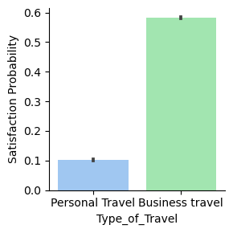




EDA – Relationship with Satisfaction

Slide 7
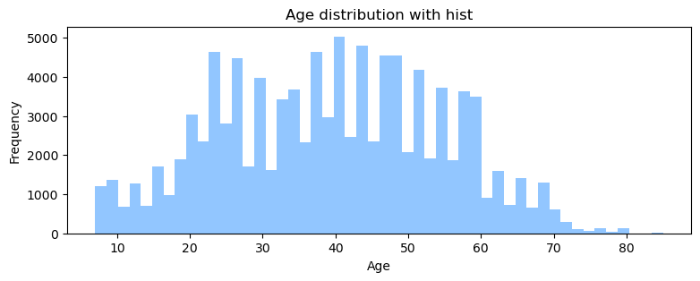
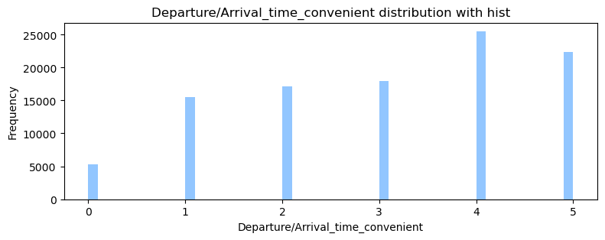
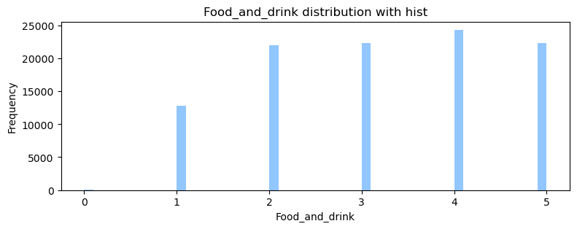
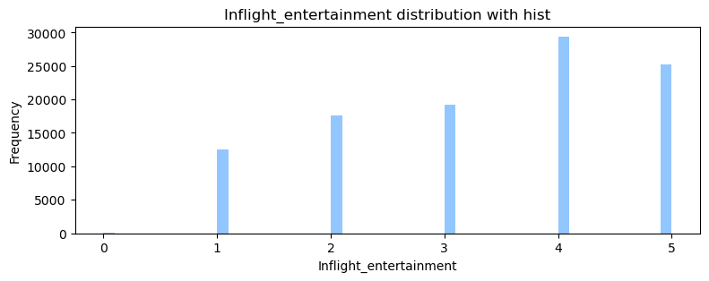
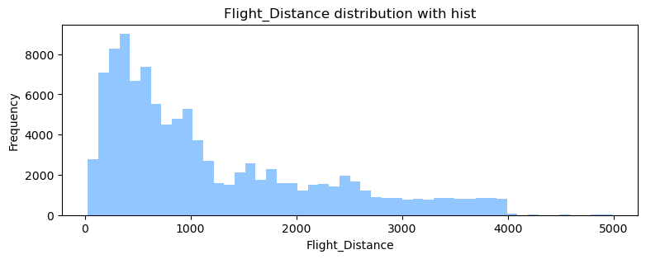
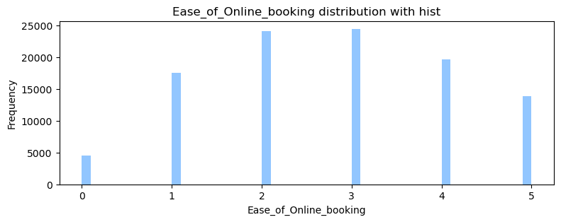
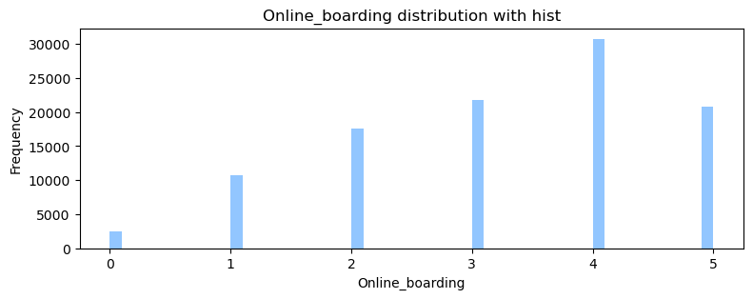
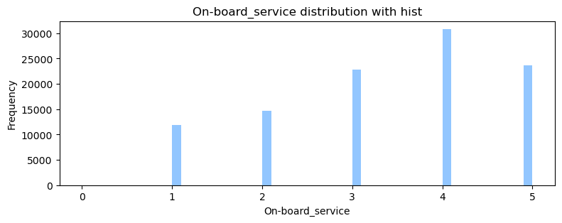
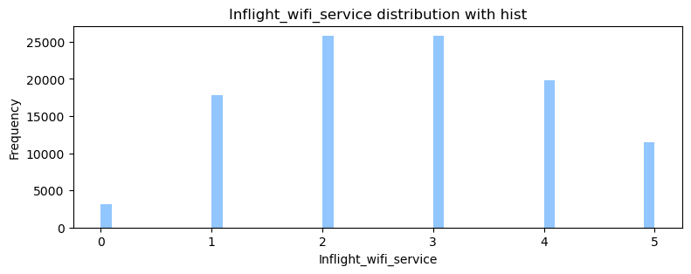
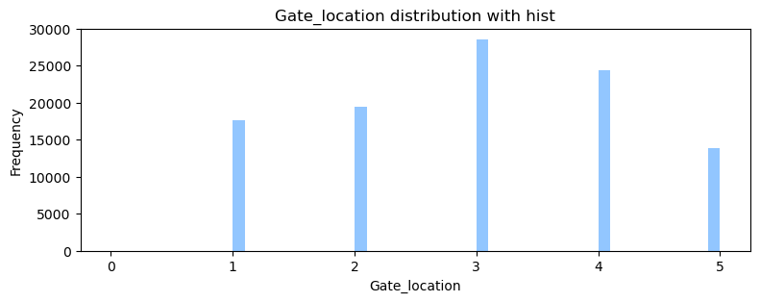
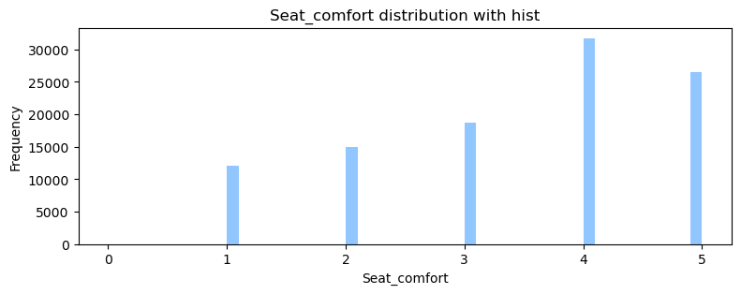
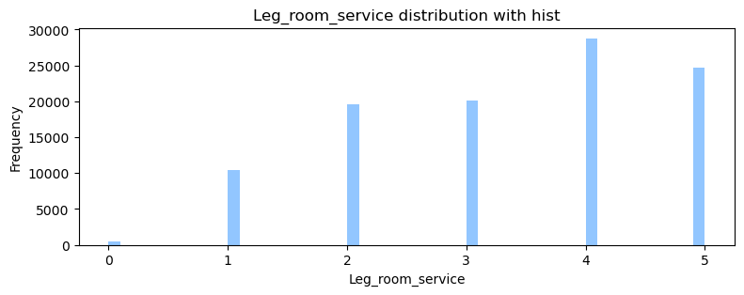
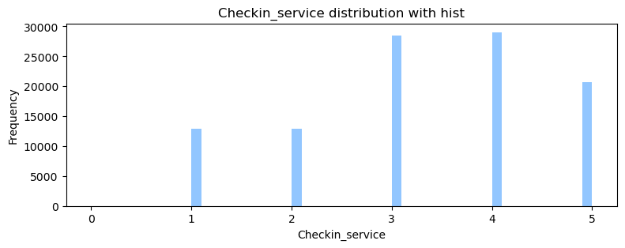
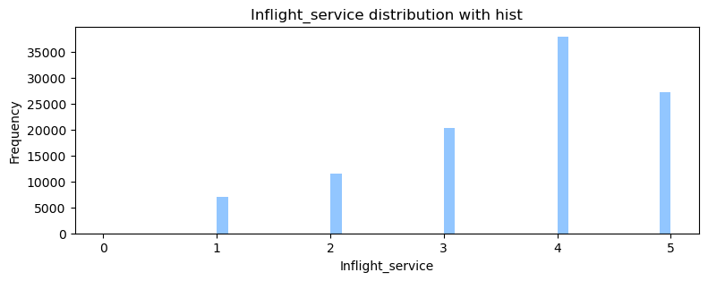
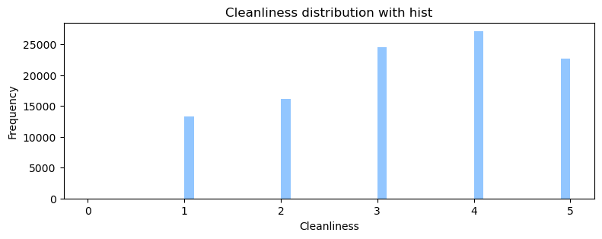
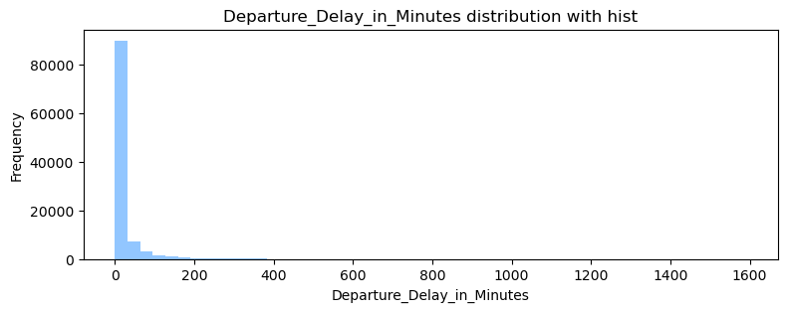
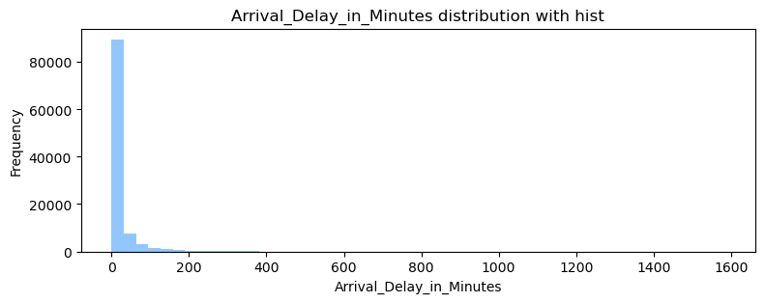
EDA – Numerical Variables Distribution

Slide 8
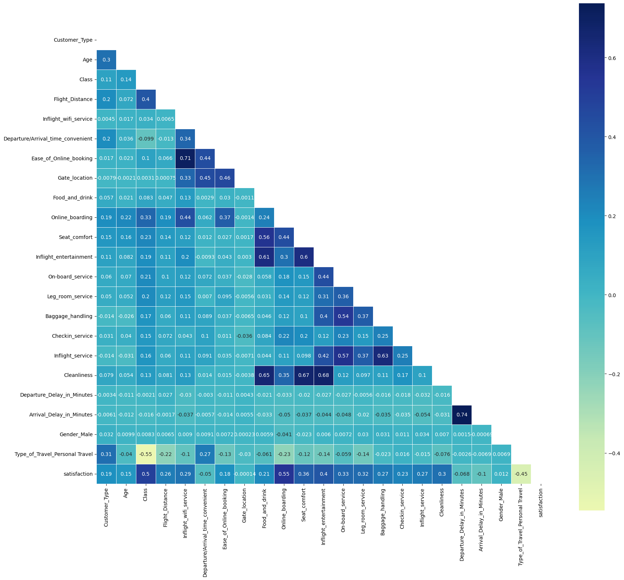
EDA - Correlation Heat Map
Shows which features correlate well with customer satisfaction.
Best features
Online Booking, Class, and Inflight Entertainment
Worst features
Type of Travel, Arrival Delay in Minutes, Departure/Arrival time convenient

Slide 9

Machine Learning Algorithms
KNN
Decision Trees Classifier
Random Forest Classifier
XGB Classifier
ADA Boost
Logistic Regression
92.89% accuracy
94.93% accuracy
96.34% accuracy
87.17% accuracy
96.33% accuracy
92.63% accuracy
1
2

Slide 10
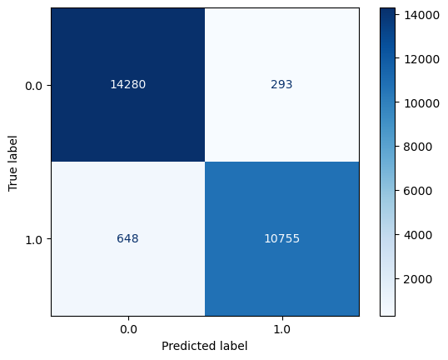
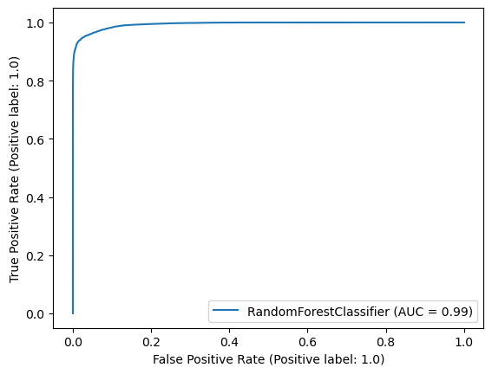
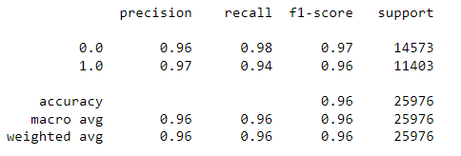
Model 1
1
Random Forest Classifier
Accuracy: 96.35%
Next steps: PCA, Grid Search
Notes:
Accuracy score of 96.35%
The confusion matrix shows Tdissatisfied 14,280 Tsatisfied 10,755
AUC = 0.99

Slide 11
Model 1: Dimensionality Reduction PCA
First PCA application
PCA(n_components = 5)
Accuracy = 89.01%
Second PCA application
PCA(0.95)
Accuracy = 93.28%
Failed to improve accuracy
Both results below 96%.
Proceeded with the original X_train and X_test value.
Notes:
Trying to get a similar accuracy with a reduced number of features.
PCA n_components = 5 – reducing to 5 features and got an accuracy of 89.01%.
In the second PCA application, I wanted my explained variance to be 95%, which led to an accuracy of 93.28%.

Slide 12
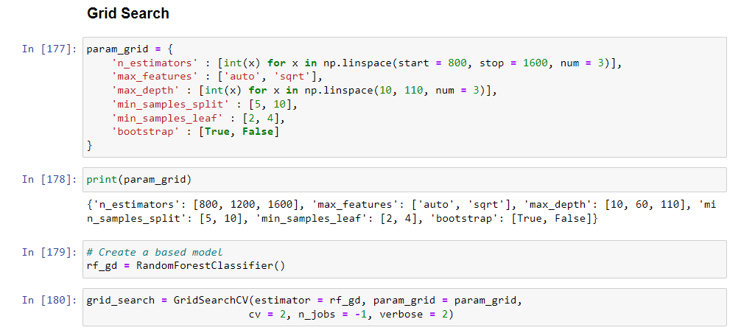
Model 1: Grid Search
6 parameters were tuned.
There were a total of 144 combinations.
Fitted 2 folds, creating 288 fits in total.

Slide 13
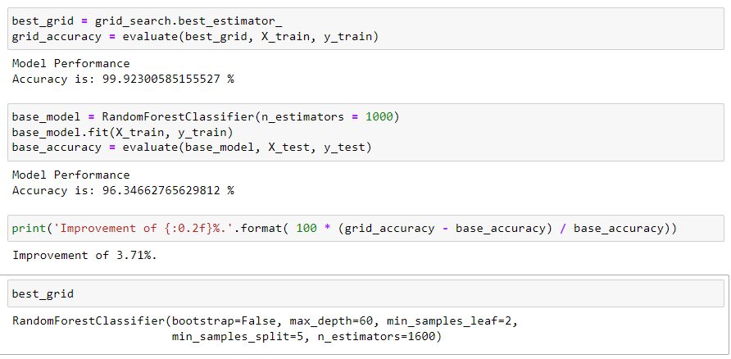
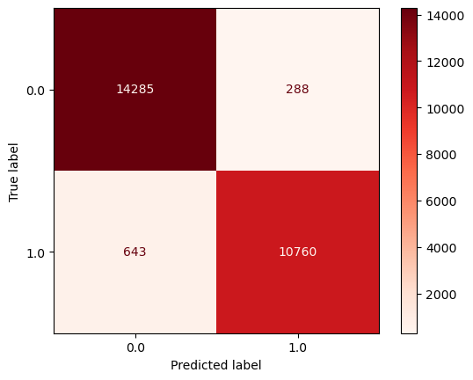
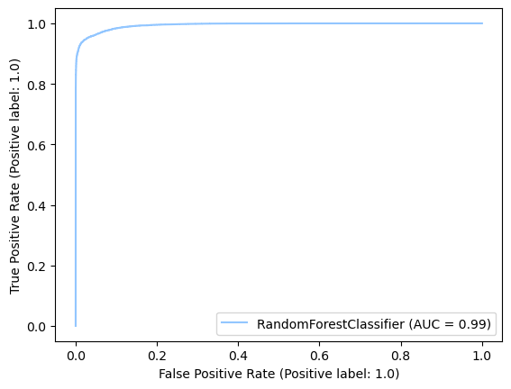
Model 1: Grid Search Results
Notes:
Accuracy score of 99.92%, which is an improvement of 3.71%.
The confusion matrix improved with Tdissatisfied 14,285 (+5) Tsatisfied 10,760 (+5)
AUC remained the same at 0.99

Slide 14

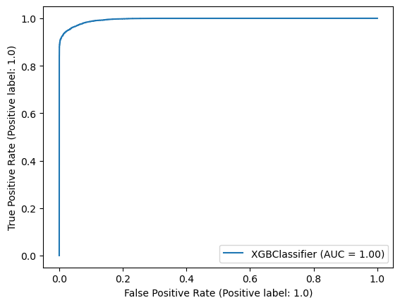
Model 2
2
Next steps: PCA, Randomized Search
XGB Classifier
Accuracy: 96.33%
Notes:
Accuracy score of 96.33%
The confusion matrix shows Tdissatisfied 14,248 Tsatisfied 10,775
AUC = 1.00

Slide 15
Model 2: Dimensionality Reduction PCA
First PCA application
PCA(n_components = 5)
Accuracy = 88.36%
Second PCA application
PCA(0.95)
Accuracy = 93.81%
Failed to improve accuracy
Both results below 96%.
Proceeded with the original X_train and X_test value.
Notes:
Trying to get a similar accuracy with a reduced number of features.
PCA n_components = 5 – reducing to 5 features and got an accuracy of 88.36%.
In the second PCA application, I wanted my explained variance to be 95%, which led to an accuracy of 93.81%.

Slide 16
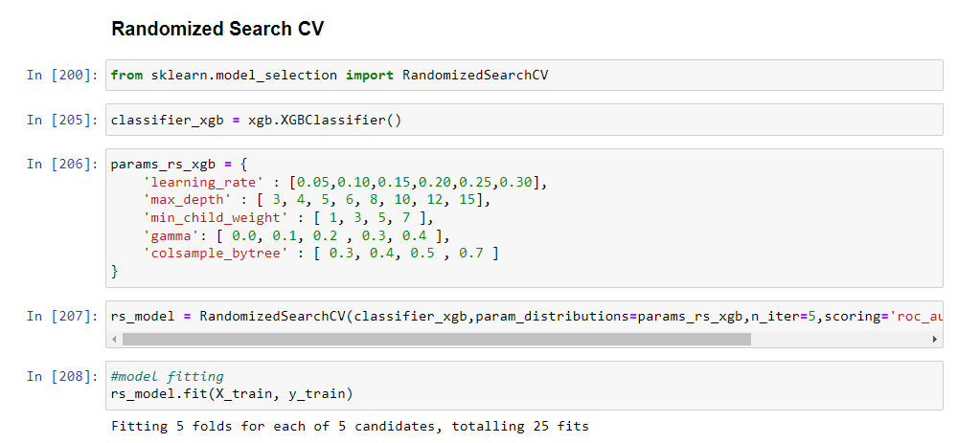
Model 1: Randomized Search
5 parameters were tuned.
Fitted 5 folds for each of the 5 candidates
Total = 25 fits

Slide 17
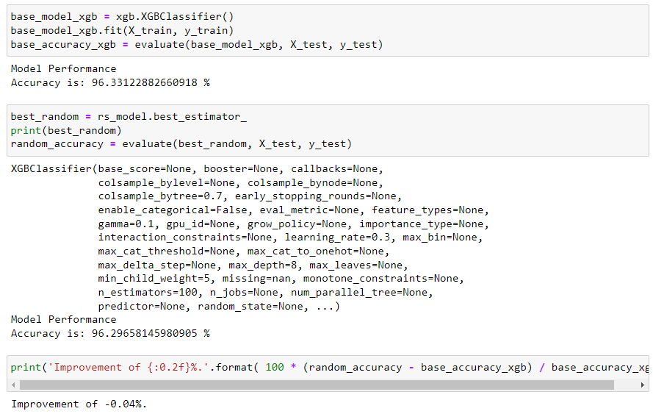

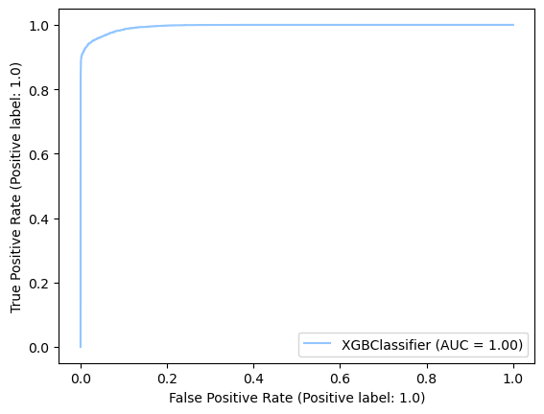
Model 2: Randomized Search Results
Notes:
Accuracy score of 96.3%, which worsened the model's accuracy of –0.04%.
The confusion matrix improved with Tdissatisfied 14,242 ( -6) Tsatisfied 10,772 (+3)
AUC improved to 1.00.

Slide 18
Modelling Conclusions
Model 1 – Random Forest Classifier with Grid Search worked best (99.92% accuracy achieved).
PCA did not help either Model 1 or Model 2 – The relationship between features were too weak.
Randomized search also did not help Model 2.
Perhaps there were too few iterations.
Can try to increase the iterations next time to have more fits, which could help with the accuracy.

Slide 19
Project Conclusions
Ease of online booking, class, inflight entertainment had the most impact on satisfaction.
Improve mobile app and website to make it accessible and easy to book flights.
Ensure that inflight entertainment are up-to-date with what is popular amongst the crowd in their 20s to 50s.
Business class were mostly satisfied, whilst eco and eco plus need significant improvement.

